Slide 1
Project_Study_3
Group Screening
1. Article review
Department of Mathematics
Gyeongsang National University
Youngmin Shin

Slide 2
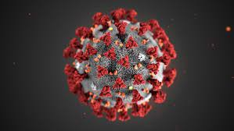
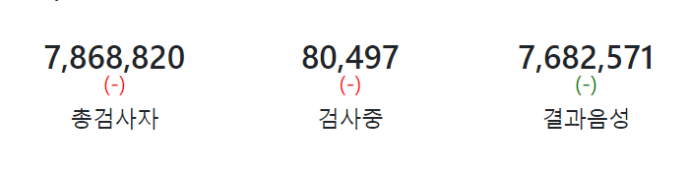
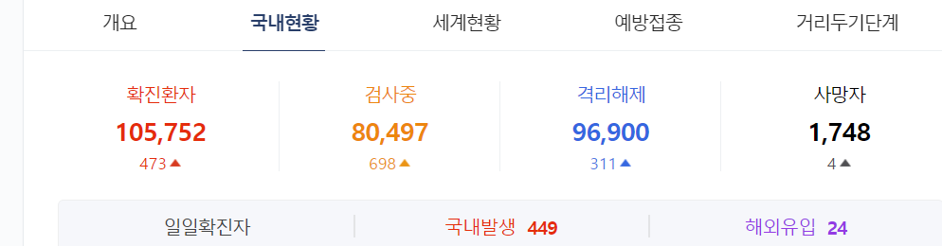
1.Introduction
p1
Notes:
컴퓨터 게임에 세상을 3d로 나타내는 방법들이 흥미로울 것 같아 이 주제를 설정해 공부해보았습니다.

Slide 3

2. Group Testing
p1
100 People
Nobody : 5
One person : 5+20=25
Notes:
https://terms.naver.com/entry.naver?docId=927612&cid=51007&categoryId=51007
Tomography : 단층촬영

Slide 4


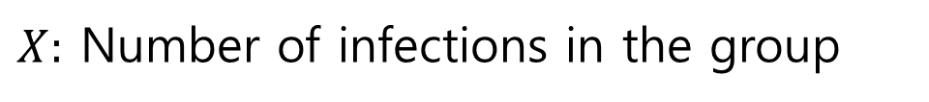
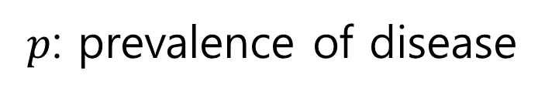

3. Optimizing the Algorithm
p1
$p$: prevalence of disease
$$p∈[0, 1]$$
$$\text{Optimal} \text{Group} \text{Size}(n≥2)$$
$X:$ Number of infections in the group
$$X\sim B(n, p)$$
Notes:
https://terms.naver.com/entry.naver?docId=927612&cid=51007&categoryId=51007
Tomography : 단층촬영

Slide 5
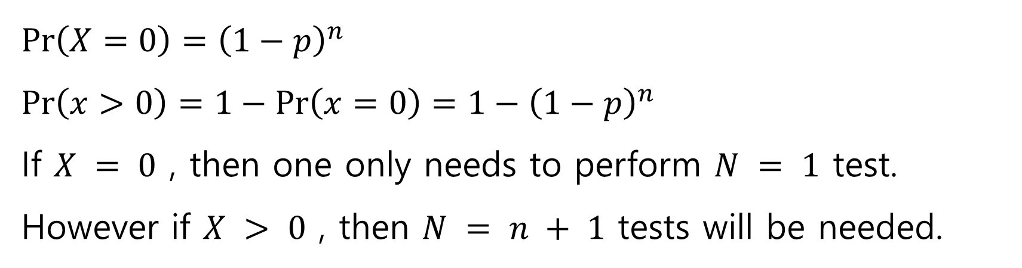
3. Optimizing the Algorithm
p1
$\operatorname{Pr}\left(X=0\right)={\left(1−p\right)}^{n}$
$\operatorname{Pr}\left(x>0\right)=1−\operatorname{Pr}\left(x=0\right)=1−{\left(1−p\right)}^{n}$
If $X = 0$ , then one only needs to perform $N = 1$ test.
However if $X > 0$ , then $N = n + 1$ tests will be needed.
Notes:
https://terms.naver.com/entry.naver?docId=927612&cid=51007&categoryId=51007
Tomography : 단층촬영

Slide 6
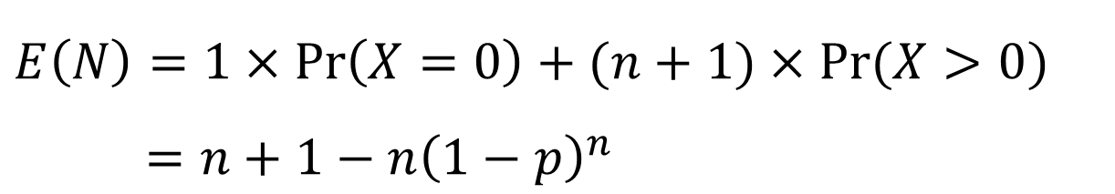
3. Optimizing the Algorithm
p1
$E \left(N\right)$: Expected number of tests to be performed.
$E\left(N\right)=1×\operatorname{Pr}\left(X=0\right)+(n+1)×Pr⁡(X>0)$
$=n+1−n{\left(1−p\right)}^{n}$
Notes:
https://terms.naver.com/entry.naver?docId=927612&cid=51007&categoryId=51007
Tomography : 단층촬영

Slide 7
3. Optimizing the Algorithm
p1
If $p = 0$ we have $E (N) = 1$.
If $p =1$ we have $E \left(N\right)=n+1$.
Notes:
https://terms.naver.com/entry.naver?docId=927612&cid=51007&categoryId=51007
Tomography : 단층촬영

Slide 8
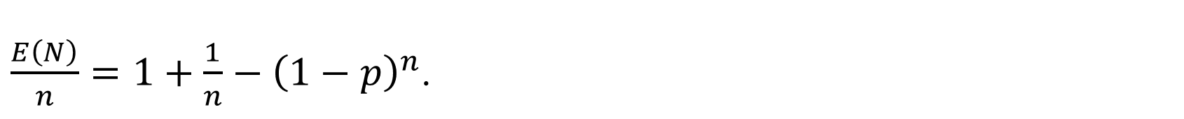
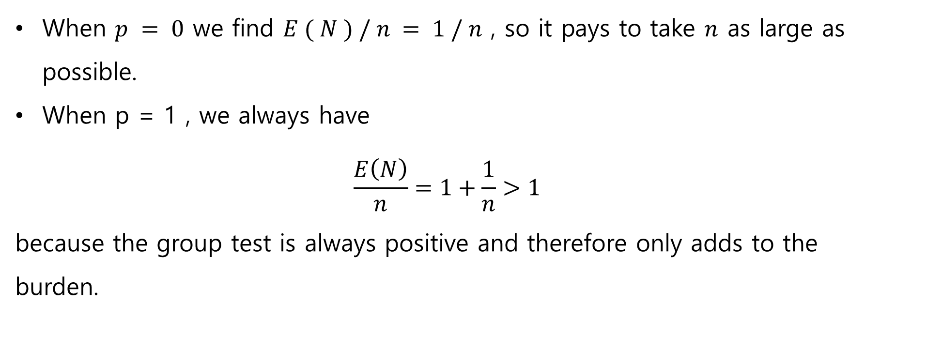
3. Optimizing the Algorithm
p1
$\frac{E\left(N\right)}{n}=1+\frac{1}{n}−{\left(1−p\right)}^{n}$.
When $p = 0$ we find $E ( N ) / n = 1 / n$ , so it pays to take $n$ as large as possible.
When p = 1 , we always have
$$\frac{E\left(N\right)}{n}=1+\frac{1}{n}>1$$
because the group test is always positive and therefore only adds to the burden.
Notes:
https://terms.naver.com/entry.naver?docId=927612&cid=51007&categoryId=51007
Tomography : 단층촬영

Slide 9
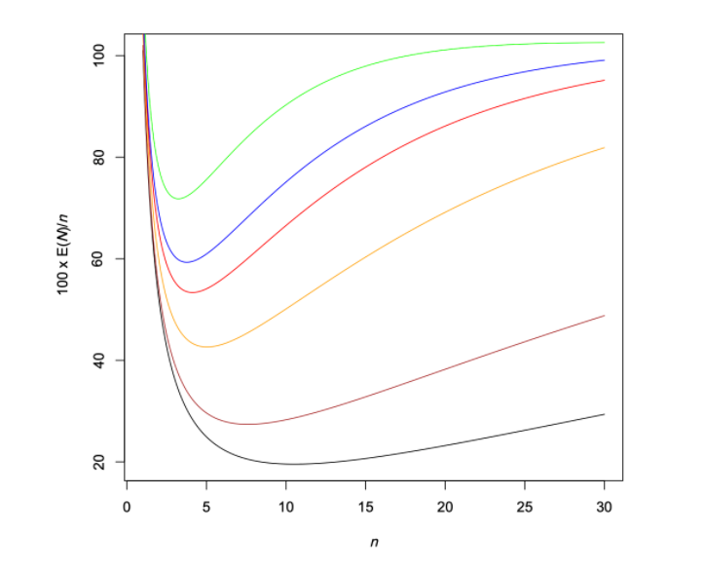
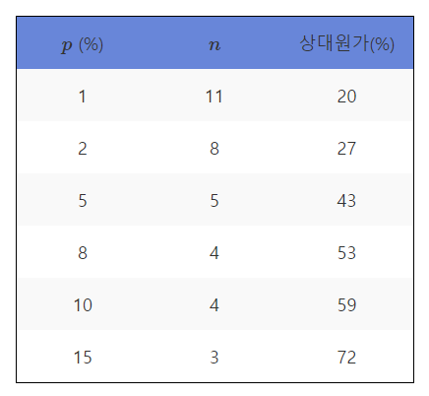
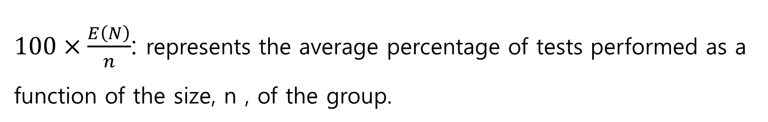
3. Optimizing the Algorithm
p1
$100×\frac{E\left(N\right)}{n}$: represents the average percentage of tests performed as a function of the size, n , of the group.
Notes:
https://terms.naver.com/entry.naver?docId=927612&cid=51007&categoryId=51007
Tomography : 단층촬영

Slide 10
4. Generalization
p1
The testing protocol described above is an example of a two-round adaptive algorithm.
Adaptive
Notes:
https://terms.naver.com/entry.naver?docId=927612&cid=51007&categoryId=51007
Tomography : 단층촬영

Slide 11
4. Generalization
p1
We can improve the performance of algorithm
Number of round
Notes:
https://terms.naver.com/entry.naver?docId=927612&cid=51007&categoryId=51007
Tomography : 단층촬영

Slide 12
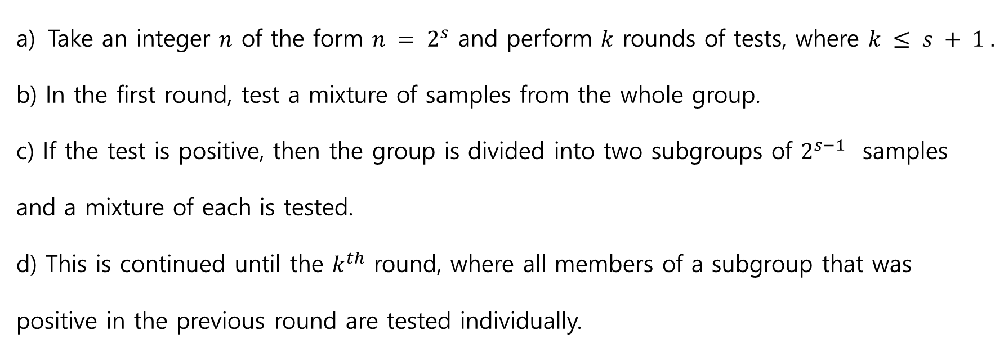
4. Generalization
p1
binary division algorithm
Take an integer $n$ of the form $n = 2^{s}$ and perform $k$ rounds of tests, where $k ≤ s + 1 .$
b) In the first round, test a mixture of samples from the whole group.
c) If the test is positive, then the group is divided into two subgroups of $2^{s−1}$ samples and a mixture of each is tested.
d) This is continued until the $k^{th}$ round, where all members of a subgroup that was positive in the previous round are tested individually.
Notes:
https://terms.naver.com/entry.naver?docId=927612&cid=51007&categoryId=51007
Tomography : 단층촬영

Slide 13
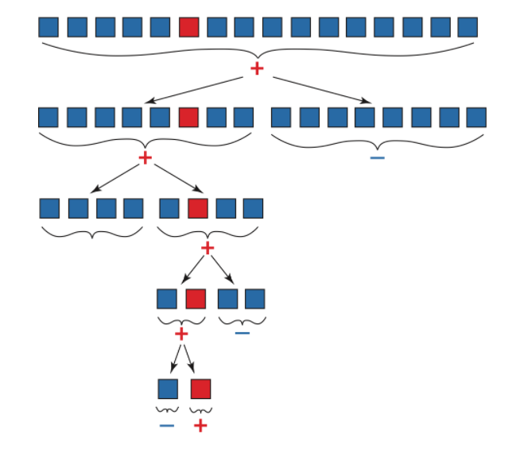
4. Generalization
p1
binary division algorithm
Time
Notes:
https://terms.naver.com/entry.naver?docId=927612&cid=51007&categoryId=51007
Tomography : 단층촬영

Slide 14
5. A non-adaptive algorithm
p1
To better control response time, non-adaptive group screening methods may also be considered.
These protocols involve only one round, allowing all tests to be performed simultaneously.
They are very effective for case detection if a reliable estimate of the prevalence of the disease is available.
Notes:
https://terms.naver.com/entry.naver?docId=927612&cid=51007&categoryId=51007
Tomography : 단층촬영

Slide 15
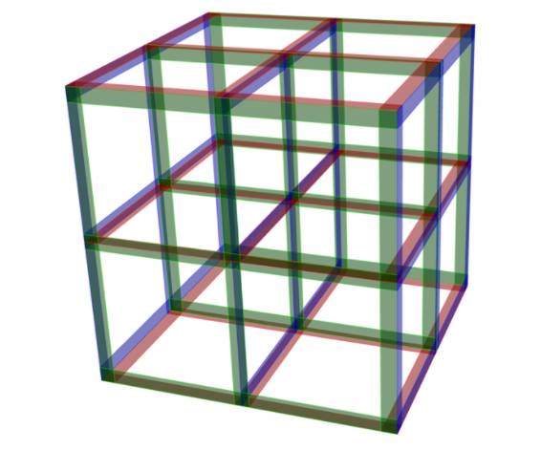
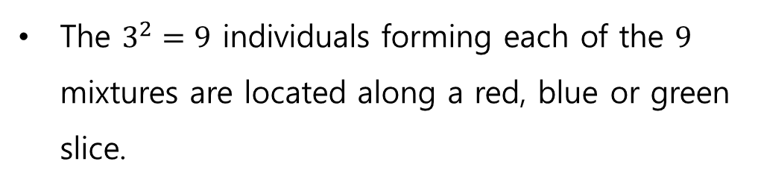

5. A non-adaptive algorithm
p1
Take $n=3^{m}$
Each point of the lattice corresponds to an individual in a random sample of size n.
The $3^{2}=9$ individuals forming each of the $9$ mixtures are located along a red, blue or green slice.
Notes:
https://terms.naver.com/entry.naver?docId=927612&cid=51007&categoryId=51007
Tomography : 단층촬영

Slide 16
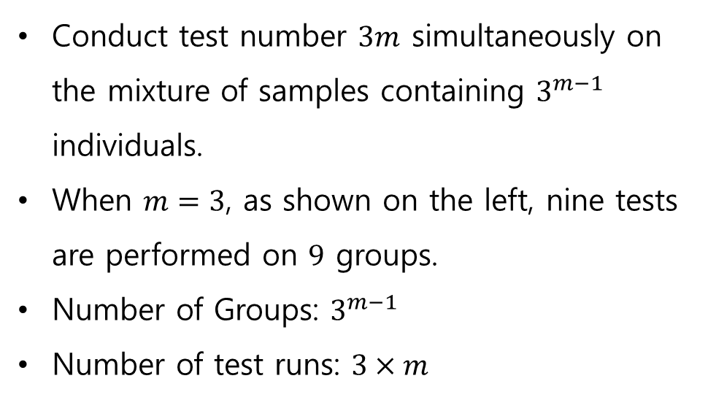
5. A non-adaptive algorithm
Conduct test number $3m$ simultaneously on the mixture of samples containing $3^{m−1}$ individuals.
When $m=3$, as shown on the left, nine tests are performed on $9$ groups.
Number of Groups: $3^{m−1}$
Number of test runs: $3×m$

Slide 17
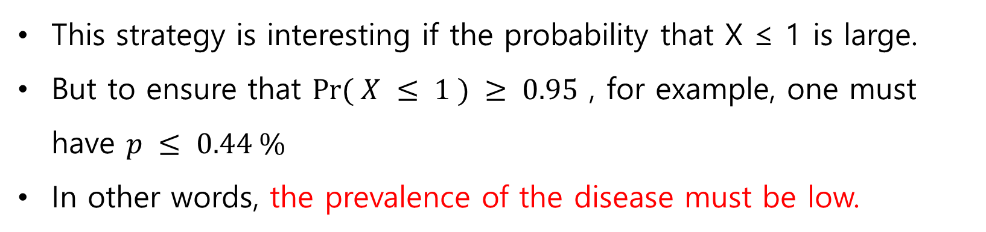
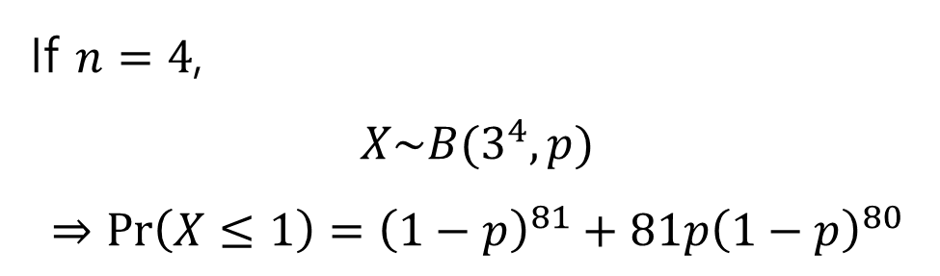
5. A non-adaptive algorithm
If $n=4$,
$$X\sim B(3^{4}, p)$$
$$⇒\operatorname{Pr}\left(X≤1\right)={\left(1−p\right)}^{81}+81p{\left(1−p\right)}^{80}$$
This strategy is interesting if the probability that X ≤ 1 is large.
But to ensure that $Pr⁡( X ≤ 1 ) ≥ 0.95$ , for example, one must have $p ≤ 0.44 \%$
In other words, the prevalence of the disease must be low.

Slide 18
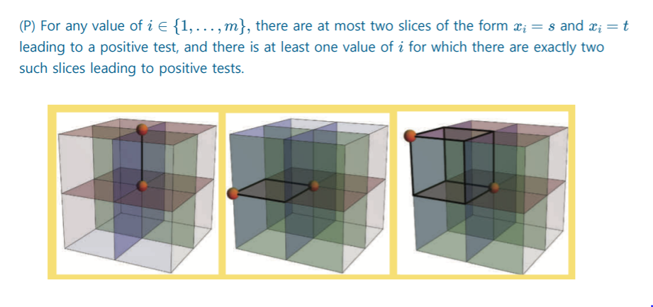
5. A non-adaptive algorithm
Costs can easily be controlled if we are clever in the way we conduct the second round when there is more than one infected individual.

Slide 19
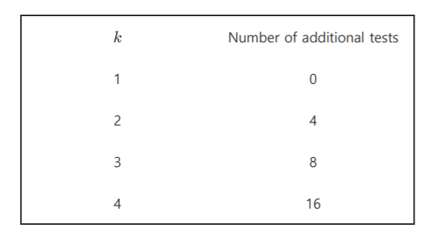
5. A non-adaptive algorithm
Additional Number of trials according to the number of infections

Slide 20
Thank you!

